Slide 1
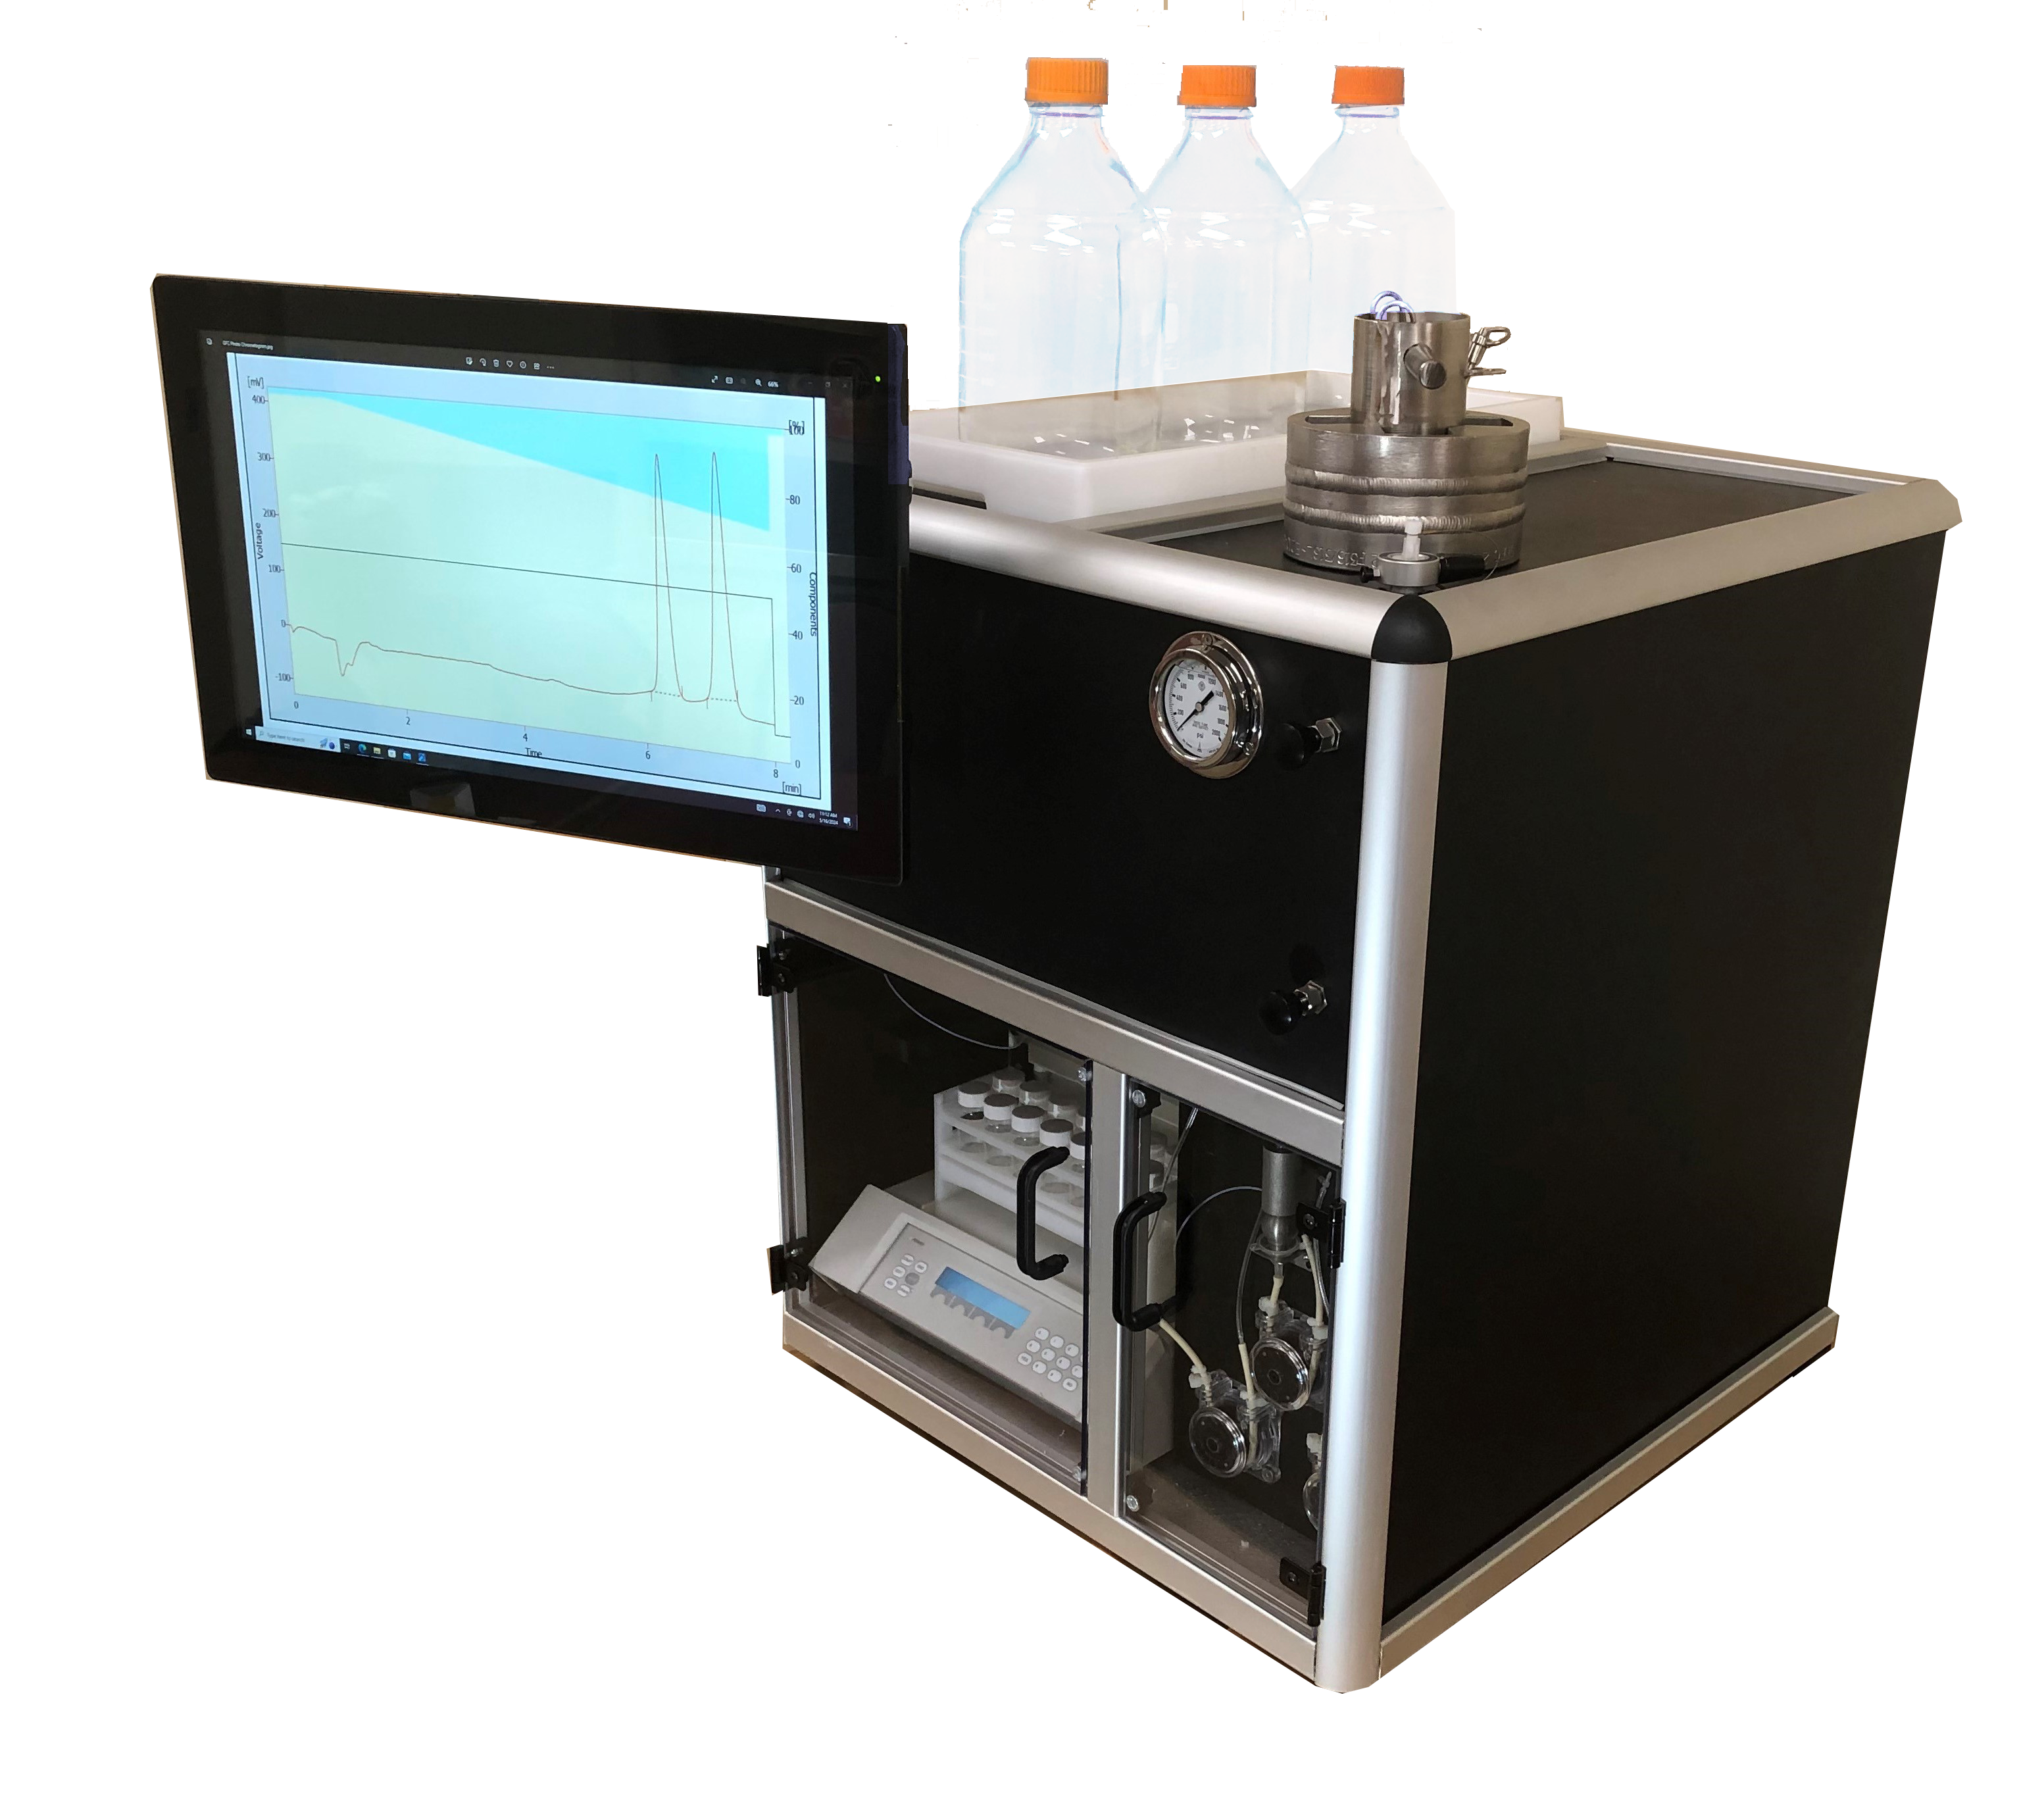
Introducing Green Flash
Chromatography, sc-CO₂ Flash
Kenneth J. James PhD
President and Director of Technology
G-Flash LLC

Slide 2
Green Flash Chromatography (G-FlashTM)
G-FlashTM replaces over 80% of the organic solvents currently used for
Traditional Flash Chromatography with supercritical carbon dioxide (sc-CO₂)
G-FlashTM Benefits :
  Less money spent on costly organic solvents and their disposal
  Improve workflow, speed and quality of separations – Less solvent to evaporate
  Enhanced workplace safety by minimizing the use of toxic, flammable solvents
  Meet demands for greener technologies and regulatory compliance
  Potential for new applications not currently possible with traditional Flash Chromatography

Slide 3
G-FlashTM Chromatography with Three Key Innovations
Our Goal was to make the transition from traditional Flash Chromatography to GreenFlash Chromatography as seamless as possible!
Key Technologies:
Accurate, reliable, pumping of liquid CO₂ utilizing Joule Thompson Expansion to cool CO₂ to bring density to ~1g/ml, an efficient way to pump highly compressible CO₂ with just one pump.
Pressure Containment Assembly enables the use of pre-packed silica gel in disposable cartridges; The same plastic flash cartridges used in traditional flash systems.
Gas/Liquid Separator applied for the first time to a Flash Chromatography System; Separated fractions are collected in exactly the same manner as a traditional Flash Chromatography system.

Slide 4
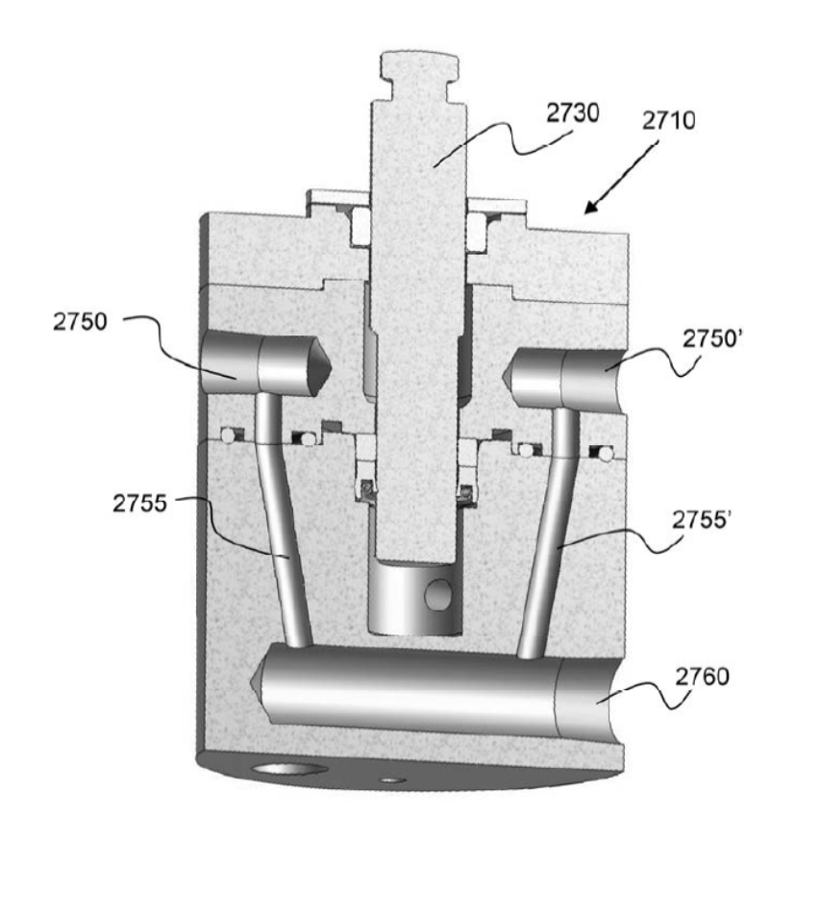
G-FlashTM Chromatography – The Technology
Joule-Thompson Expansion to cool CO₂ raising the Density to ~1g/ml for efficient pumping

Slide 5
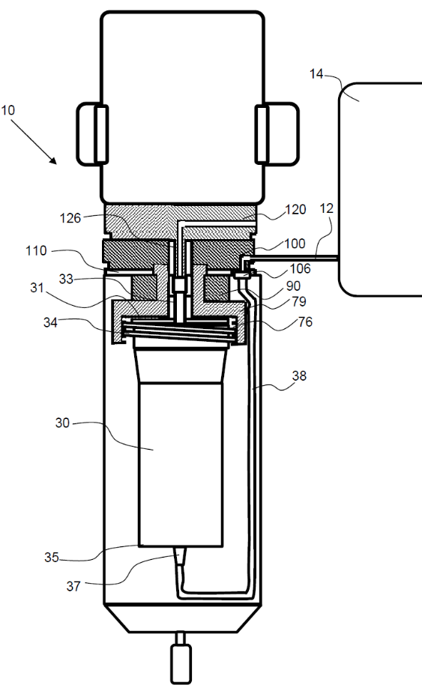
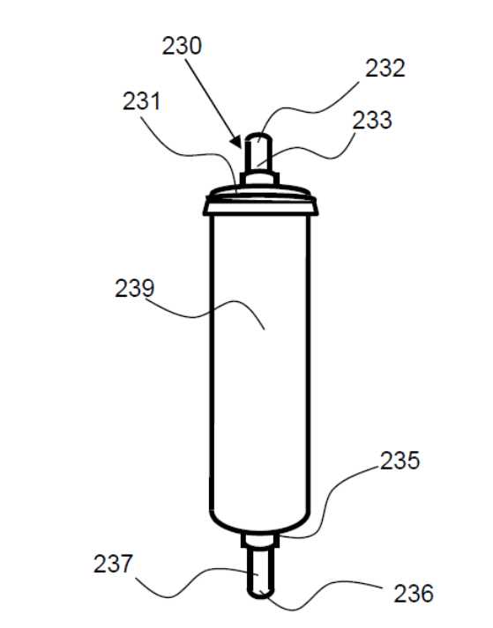
G-FlashTM Chromatography – The Technology
Pressure Containment Assembly (PCA) to allow the use of traditional disposable flash cartridges

Slide 6
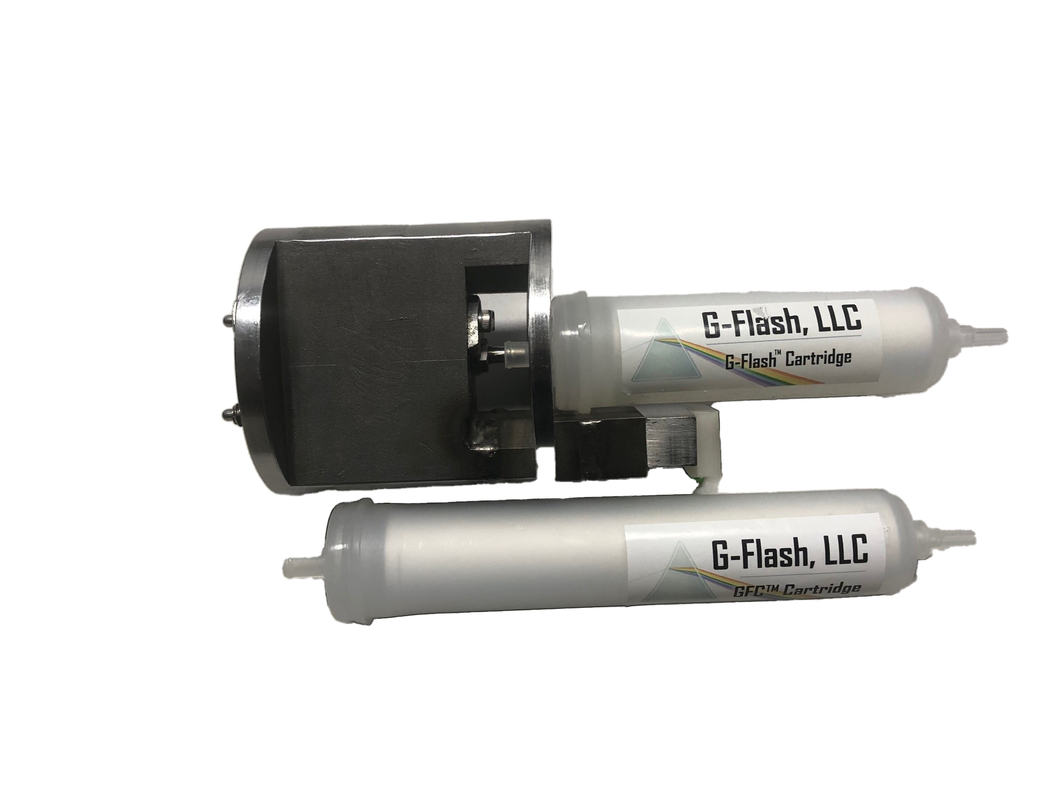
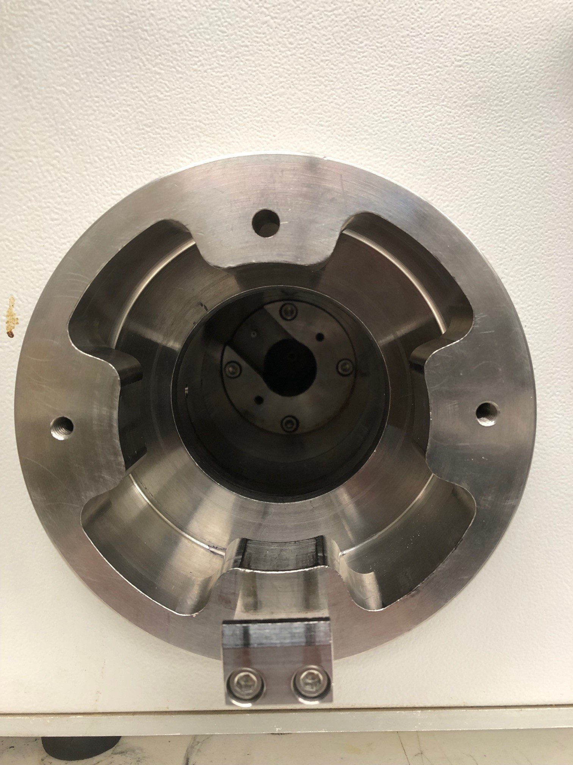
G-FlashTM Chromatography – The Technology
Interchangeable Cartridge Fixture for GFC, Simple Loading/Unloading

Slide 7
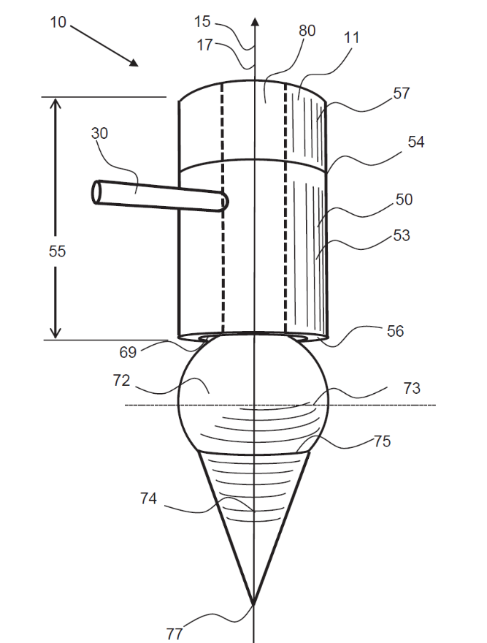
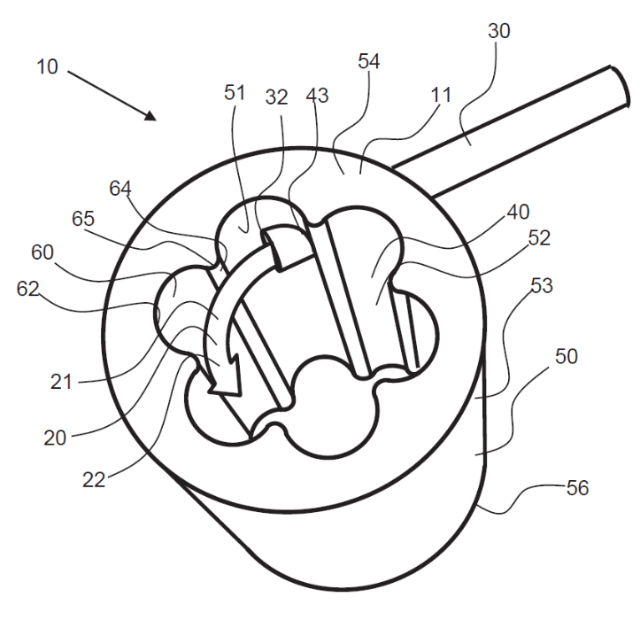
G-FlashTM Chromatography – The Technology
Gas Liquid Separator to efficiently collect the separated effluent

Slide 8
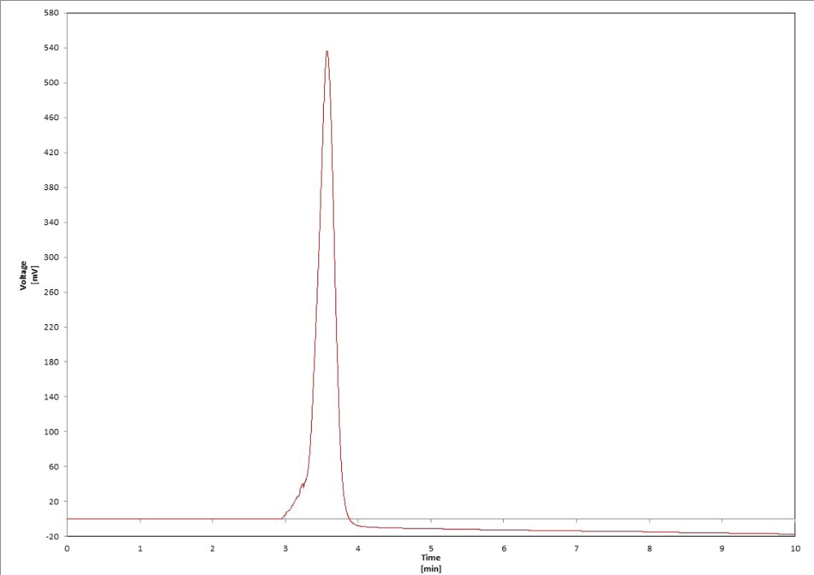
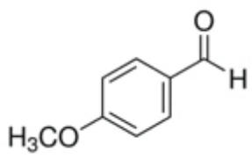
G-FlashTM Chromatography – Chromatography
p-Anisaldehyde: sc-CO₂/Ethyl Acetate – 254nm 5-20% Ethyl Acetate Gradient, 12g/15micron Cartridge

Slide 9
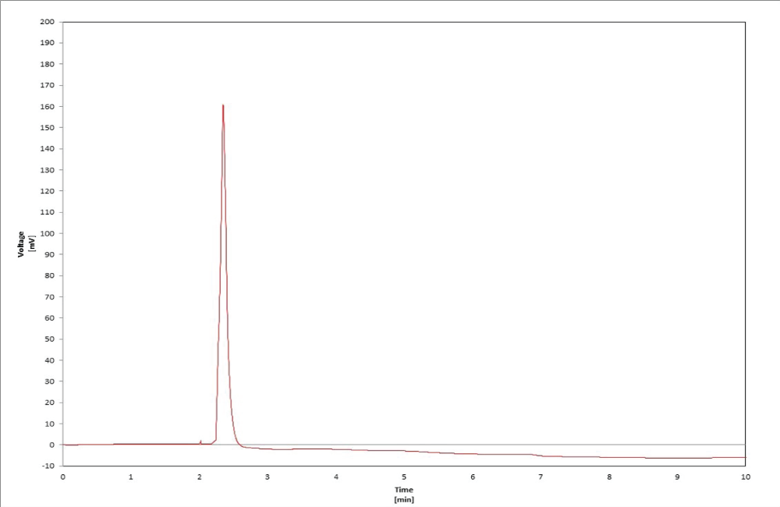
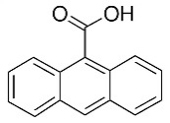
G-FlashTM Chromatography – Chromatography
9-Anthracene: sc-CO₂/Ethyl Acetate – 254nm, 5-20% Ethyl Acetate Gradient, 12g/15 micron Cartridge

Slide 10
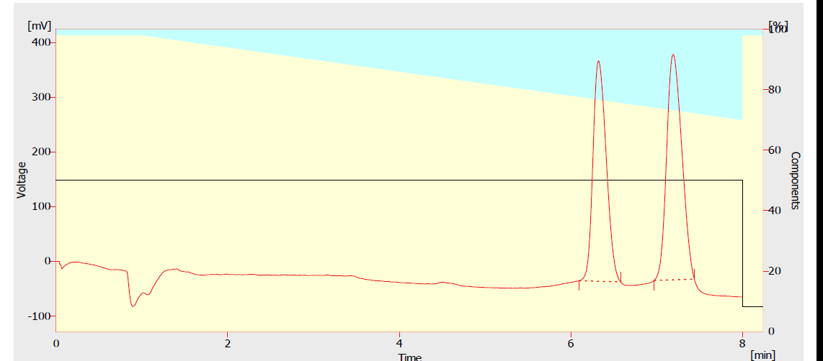
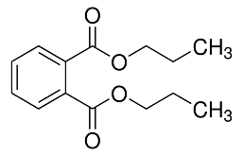
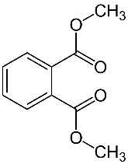
G-FlashTM Chromatography – Chromatography
Separation of Alkyl Phthalates, 280nm, 5-15% Methanol Gradient, 25mls/min, 12g, 25- micron Cartridge

Slide 11
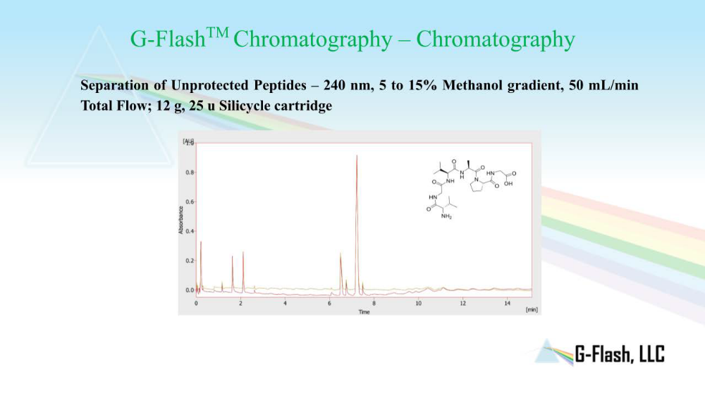

Slide 12
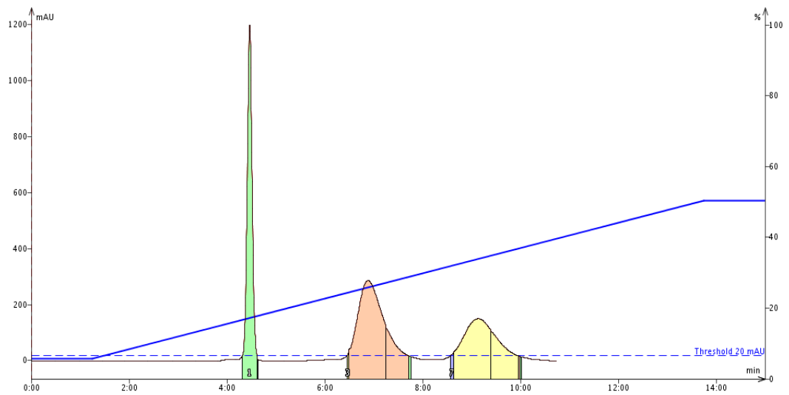
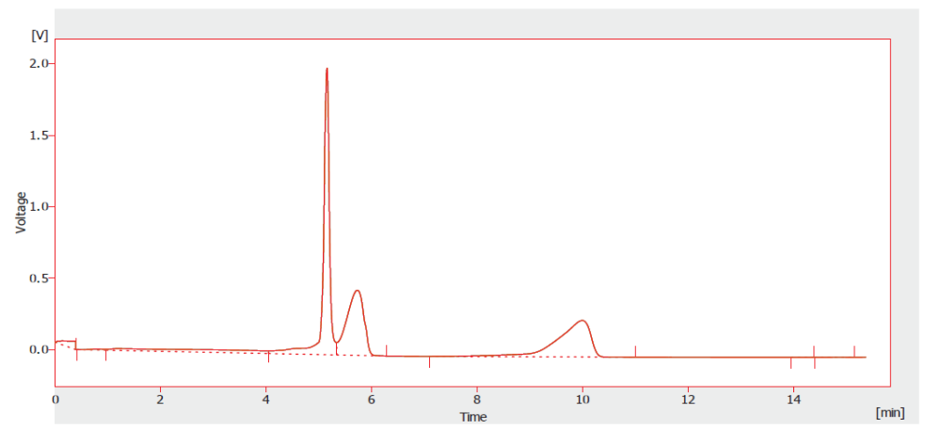
Traditional Flash vs. G-FlashTM Chromatography Comparison
Quinoxaline, Butyl-4-Hydroxybenzoate, and N-(4-Methoxyphenyl)acetamide
Traditional Flash Liquid Injection Spherical 45g 25µm
3 comp suite in IPA 0.5% load
GFC Spherical 25um, CO₂/methanol
3 comp suite in IPA 0.5% load
GFC Spherical 25um, CO₂/methanol
Solvent A: n-Heptane Solvent B: IPA
Gradient: B 5% - 1.15mins
5-50% - 12.30mins
50% - 1.15mins
Detection Mode: UV 280nm
Flow Rate: 60ml/min Inj. volume:1.1ml of 200mg/ml in IPA
Solvent A: Carbon Dioxide Solvent B: Methanol
Gradient: B 2-15% 0-12.30 mins
Detection Mode: UV 280nm Pres: 1700 psi / Temp: 50ºC
Flow Rate: 100ml/min Inj. Volume:1.1ml in IPA

Slide 13
Cost Analysis – G-FlashTM vs. Traditional Flash Chromatography
Single Separation Comparison *
 | G-Flash | Traditional Flash
Non-Polar Solvent | $ 0.43 | $ 48.73
Polar Solvent | $ 4.38 | $ 4.38
Nitrogen | $ 0.61
Solvent Disposal | $ 4.38 | $ 53.11
Total | $ 9.80 | $ 106.22
- Based on data we found that a traditional Flash unit is used 5-10 times per day.
- Being conservative, 5 times/day x 5 days/week x 50 weeks per year = 1250 runs/year.
GFC: $12,250. Traditional Flash: $132,775.
^{Cost savings ~11 to 1}
      *Solvent Usage Only, Does not include the workflow advantage.
      Assumed: Electrical consumption and cartridge cost equivalent.
      Assumed: Solvent disposal cost the same as acquisition cost.

Slide 14
Comments from Key Researchers at Major Pharmaceutical Companies who have seen the G-FlashTM Pre-Commercial Unit
This greatly reduced solvent consumptions and that’s a big cost savings.
GreenFlash will make our chemists more productive (workflow!)
We could replace 90% of our traditional Flash instruments with GFC.
I wish we had this during the Acetonitrile shortage.
This is not another version of an SFC instrument, it is the next generation of Flash Chromatography.
Traditional Flash cannot separate Biomolecules. The potential for performing some of these
separations with GFC is of great interest to us.
We Believe GreenFlash Chromatography is the future!

Slide 15
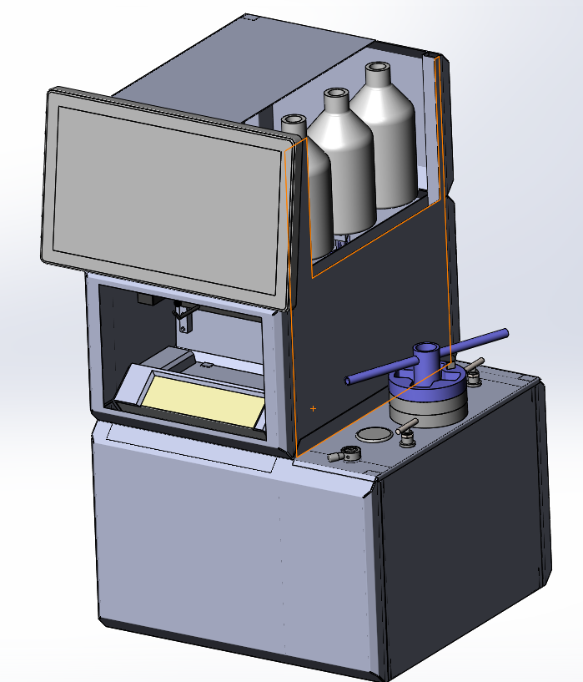
Current Design of the G-Flash Chromatography System
Gathered feedback from potential users with precommercial unit
Validated design
Reworked critical components for robustness and operational longevity
Designed for manufacturing

Slide 16
G-FlashTM Intellectual Property
US Patent #10,765,968: “Supercritical Fluid Chromatography System”
US Patent #10,610,808: “Systems and Methods for Supercritical Fluid Chromatography”
US Patent #11,022,350: “Cooling Loop with Supercritical Fluid System Using Compressed Refrigerant Fluid Flow with a Positive Joule-Thompson Coefficient”
US Patent #11,680,735: “Supercritical Fluid Chromatography System”
US Patent #11,913,685: “Cooling Loop with Supercritical Fluid System Using Compressed Refrigerant Fluid Flow with a Positive Joule-Thompson Coefficient”
US Patent #11,946,915: “Interchangeable Chromatography Cartridge Adapter System”
US Patent #12,036,566: “Gas-Liquid Separator Assembly”
US Patent 12,460,842 “Interchangeable Chromatography Cartridge Adapter System”

Slide 17
Thank You !
Questions Are Always Welcome
_______________________________
We thank you for your time, interest, and enthusiasm

